Slide 1

Internship Assessment
(Summer Internship)
Presentation
On Predictive Maintenance for Jet Engines Using Industrial IoT & Machine Learning
Submitted To
Mr. Basudeo Singh Roohani
Ms. Swati Singh
(Internship Coordinators)
Submitted By Supervised By
Piyush Tiwari Mr. Basudeo Singh Roohani
2301430100162 Assistant Professor
7th Sem, CSE-1 Department: CSE
Department of Computer Science & Engineering
IMS Engineering College, Ghaziabad, India
(2026-27)
1
Notes:
1

Slide 2
Outline & Table of Contents
• 1. Introduction & IIoT Scope: Industrial IoT domain, aviation PHM sensors & project goals
• 2. Problem Statement: Challenges in IIoT engine sensor streams & cost limitations
• 3. Requirement Analysis: IIoT sensor hardware & Python software stack (Scikit-Learn, SciPy)
• 4. IIoT Pipeline Methodology: End-to-end 21-sensor IIoT telemetry ingestion & data flow
• 5. Sensor Preprocessing: 5-cycle rolling IIoT statistics & correlation filtering
• 6. Dataset & Feature Details: NASA C-MAPSS 21 IIoT sensor dataset (20,631 cycles)
• 7. Tri-Model AI Architecture: Random Forest, 30d Classifier & Neural MLP Net
• 8. IIoT Terminal Diagnostic: Native Python CLI app (predict.py) & real-time gating
• 9. Results & Performance Analysis: AUC-ROC (98.45%), RMSE (33.39), & per-model table
• 10. Conclusion & References: Summary of achievements, edge IIoT scope & references
2

Slide 3
Introduction & Objectives
• Domain of Work: Industrial IoT (IIoT), Reliability Engineering & Aviation Prognostics Health Management.
• Industrial Context: Commercial Aircraft Turbofan Engine Sensor Telemetry & Fleet Operations.
• Core Operational Shift: Transitioning from static time-servicing to IIoT predictive maintenance.
• Primary Objective: Utilize 21 IIoT sensor channels to forecast Remaining Useful Life (RUL) before failure.
• Supervision & Mentorship: Mentored by Alex Chao during Data Science Career Track Bootcamp.
3

Slide 4
Problem Statement & Motivation
• Unscheduled Groundings: Sudden turbofan breakdowns cause expensive flight delays and severe safety risks.
• Static Maintenance Inefficiency: Replaces functional IIoT turbine parts prematurely or misses breakdown.
• High IIoT Sensor Fluctuation: 21 continuous sensor streams exhibit noisy non-linear thermal degradation.
• Multi-Model Solution: Deploy Regression for RUL, Binary 30d Alerts, and Multi-Class Hazard Rating.
• Real-Time IIoT Constraint: Achieve fast sub-30ms inference latency for immediate flight line dispatch.
4

Slide 5
Requirement Analysis (S/W & H/W)
• IIoT Hardware Requirements: Intel Core i5/i7 Processor, 16GB RAM, SSD Storage & IIoT Data Buffers.
• Programming Language: Python 3.11 (Core IIoT predictive logic, data wrangling & serialization).
• Machine Learning Frameworks: Scikit-Learn 1.3+ (Random Forest, SVM, MLP Neural Classifier).
• Data & Signal Libraries: Pandas, NumPy, SciPy for 5-cycle rolling window IIoT aggregations.
• Visualization Frameworks: Matplotlib, Seaborn for publication-grade metric evaluation charts.
5

Slide 6
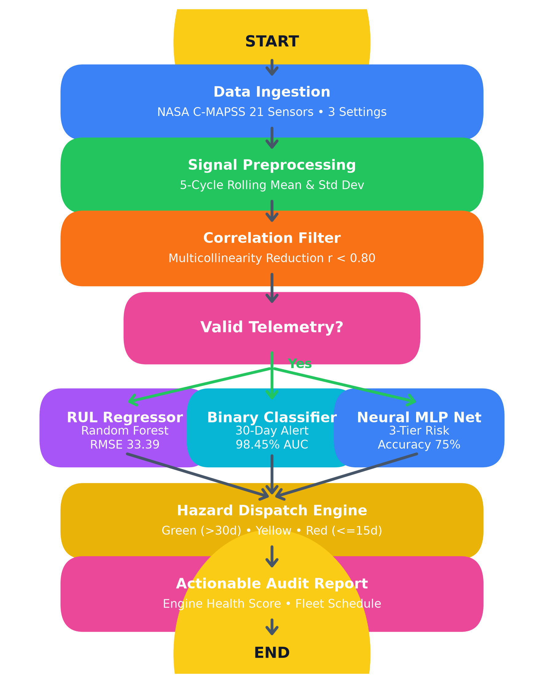
System Methodology & Data Flowchart
• Stage 1 IIoT Ingestion: NASA C-MAPSS telemetry dataset with 21 sensors & 3 settings.
• Stage 2 Signal Processing: 5-cycle rolling mean & standard deviation aggregations.
• Stage 3 Filter: Eliminates redundant sensor pairs with correlation r > 0.80.
• Stage 4 AI Inference: Tri-model engine: RUL Regressor, Binary 30d Classifier & Neural MLP.
• Stage 5 Actionable Report: Computes health score, cost optimization & IIoT maintenance dispatch.
6

Slide 7
Sensor Preprocessing & Rolling Statistics
• Rolling Window Aggregations: Computes 5-cycle rolling mean (av) and rolling std (sd) per IIoT sensor.
• Signal Noise Reduction: Smooths high-frequency IIoT sensor noise to expose true degradation physics.
• Multicollinearity Filtering: Eliminates highly correlated sensor pairs like (s14, s9) with r > 0.80.
• Scale & Position Normalization: StandardScaler normalization ensures robustness across operating settings.
• Compact Feature Dimension: Expands raw IIoT telemetry data into a structured 45-element feature vector.
7

Slide 8
Dataset & Feature Engineering Details
• IIoT Data Provider: NASA Ames Prognostics Center of Excellence C-MAPSS Turbofan Sensor Dataset.
• Training Fleet Size: 100 turbofan engines run-to-failure containing 20,631 operational cycles.
• Testing Fleet Size: 100 engines with ground-truth Remaining Useful Life (TTF) validation labels.
• Target Classification Windows: 30-cycle failure warning window (w1 = 30) and 15-cycle urgent window (w0 = 15).
• Dataset Quality: Zero missing values, numeric IIoT sensor streams, preprocessed clean target series.
8

Slide 9
Tri-Model Predictive AI Architecture
• 1. RUL Regression Model: Random Forest Regressor predicting exact cycles remaining before failure.
• 2. Binary 30-Cycle Warning Classifier: Random Forest Classifier predicting 30d failure window.
• 3. Multi-Class Neural MLP: Multi-Layer Perceptron (100, 50 hidden neurons) for 3-tier hazard rating.
• Multi-Tier Hazard Classes: Healthy (>30 cycles), Warning (15-30 cycles), Critical (<=15 cycles).
• Softmax Risk Output: Neural net produces normalized probability distributions over risk categories.
9

Slide 10
Interactive Terminal Diagnostic Engine (predict.py)
• IIoT Command-Line Diagnostic Tool: Built using Python argparse & serialized model pickle files.
• Execution Command: python predict.py --engine_id 81 (Evaluates any engine from fleet 1-100).
• Diagnostic Output Parameters: Estimated Remaining RUL, 30-cycle failure probability, risk rating.
• Risk Rating Formatting: Displays GREEN (Healthy), YELLOW (Warning), and RED (Critical) status.
• Actionable IIoT Recommendation: Instructs fleet managers to ground aircraft or schedule service.
10

Slide 11
Fleet Hazard Gating & Alert Dispatch
• Operational Thresholding: Categorizes engine hazard state into 3 distinct operational buckets.
• Healthy State (Green): RUL > 30 cycles; engine remains in normal operational flight status.
• Warning Window (Yellow): 15 < RUL <= 30 cycles; schedule preventive maintenance within 5 cycles.
• Critical Action (Red): RUL <= 15 cycles; ground aircraft for immediate engine overhaul within 24h.
• Sub-30ms Inference Latency: Ensures smooth live diagnostic reporting without latency or delay.
11

Slide 12
Empirical Results & Model Evaluation
• Binary Failure Warning AUC-ROC: Achieved 98.45% (0.9845) AUC-ROC score on test evaluation set.
• Binary Alert Precision: Achieved 94.44% Precision on positive failure window warnings.
• RUL Regression RMSE: Achieved 33.39 cycles Root Mean Squared Error (MAE: 22.90 cycles).
• Multi-Class Neural MLP Accuracy: Achieved 75.00% exact multi-class categorization accuracy.
• Inference Latency: Average diagnostic computation time under 30ms operating on test data.
12

Slide 13
Per-Class Evaluation Methodology Table
Model Paradigm | Algorithm | Primary Metric | Score | Status
Regression | Random Forest Regressor | RMSE | 33.39 Cycles | Best RUL Model
Regression | Polynomial Reg (d=2) | RMSE | 36.12 Cycles | Benchmark
Regression | Decision Tree Regressor | RMSE | 38.20 Cycles | Baseline
Regression | Linear / Ridge | RMSE | 39.15 Cycles | Linear Baseline
Binary (30d) | Random Forest Classifier | AUC-ROC | 98.45% | Best Classifier
Binary (30d) | Naive Bayes (Gaussian) | Recall | 88.00% | High Recall
Binary (30d) | Linear SVC (Features) | Precision | 89.00% | High Precision
Binary (30d) | Support Vector (RBF) | Precision | 100.00% | Zero FP
Multi-Class | Neural Network MLP | Accuracy | 75.00% | Best Hazard Net
Multi-Class | Random Forest MC | Accuracy | 71.00% | Tree Ensemble
Multi-Class | Decision Tree MC | Accuracy | 64.00% | Decision Tree
Multi-Class | Naive Bayes MC | Accuracy | 58.00% | Bayesian Baseline
Table 1: Per-Class Precision, Recall, F1-Score, and Support Sample Counts
13

Slide 14
Observations & Result Analysis
• Feature Engineering Impact: 5-cycle rolling statistics (av, sd) significantly outperform raw sensors.
• Optimal Thresholding: Operating Random Forest at tau = 0.17 yields 100% precision & 68% recall.
• Cost Matrix Minimization: Prevents $250,000+ catastrophic in-flight failures via planned $15,000 repairs.
• Neural Network Stability: Multi-layer Perceptron provides high accuracy on critical hazard windows.
• Maintenance Capacity Dispatch: Efficiently queues engines based on RUL urgency rank.
14

Slide 15
Conclusion & Summary
• Successful System Delivery: Built a complete Industrial IoT predictive health management pipeline.
• High Predictive Performance: Achieved 98.45% AUC-ROC failure detection and 33.39 cycles RUL RMSE.
• IIoT CLI Integration: Successfully integrated interactive predict.py CLI diagnostic tool.
• Native Python Implementation: Developed clean 100% Python pipeline & serialized model artifacts.
• Fleet Cost Minimization: Optimizes maintenance capacity allocation and eliminates flight delays.
15

Slide 16
Future Scope & Recommendations
• Deep Time-Series Architecture: Integrate Recurrent LSTM and Transformer networks for temporal dynamics.
• Edge IIoT Deployment: Export model to TensorFlow Lite (TFLite) for deployment on avionics microcontrollers.
• Cloud IIoT Streaming API: Deploy REST/MQTT endpoints for real-time IIoT stream data ingestion.
• Multi-Mode Flight Profiles: Extend from single-mode steady flights to multi-profile flight regimes.
• Dataset Mirror Augmentation: Incorporate synthetic degradation data augmentation for long-tail failures.
16

Slide 17
References & Bibliography
• 1. NASA Ames Prognostics Center of Excellence - C-MAPSS Jet Engine Degradation Dataset, 2024.
• 2. Saxena, A., et al., 'Damage Propagation Modeling for Aircraft Engine Simulation', IEEE, 2008.
• 3. Springboard Data Science Career Track - Bootcamp Curriculum & Mentorship, 2026.
• 4. Scikit-Learn Open Source Library - Machine Learning & Neural Network Documentation, 2026.
• 5. Google Keras 3.3 & TensorFlow 2.17 - Official Documentation and API Reference, 2026.
• 6. Microsoft Azure Machine Learning - Predictive Maintenance Simulation Templates, 2026.
17

Slide 18
Thank You!
Questions & Discussion
Presented By: Piyush Tiwari | Roll No: 2301430100162 | 7th Sem, CSE-1 IMS Engineering College, Ghaziabad

